Slide 1
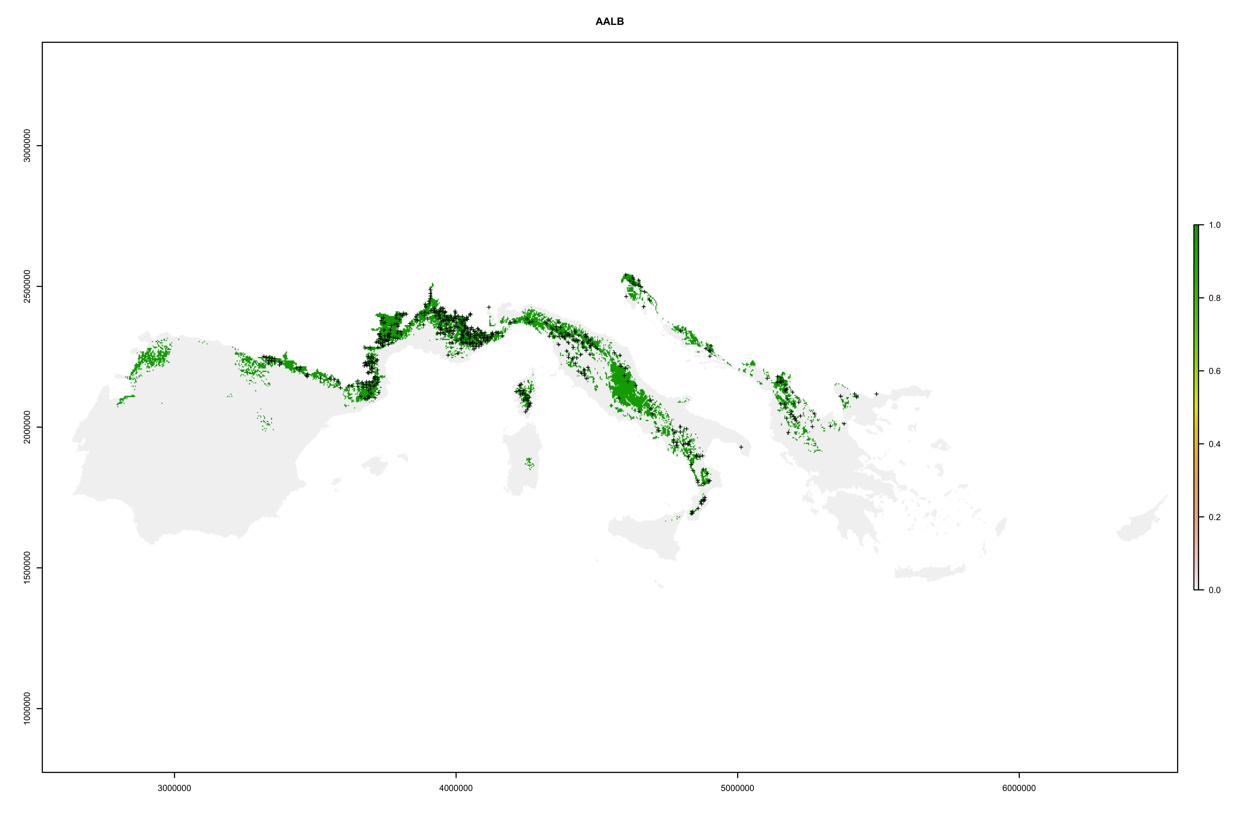
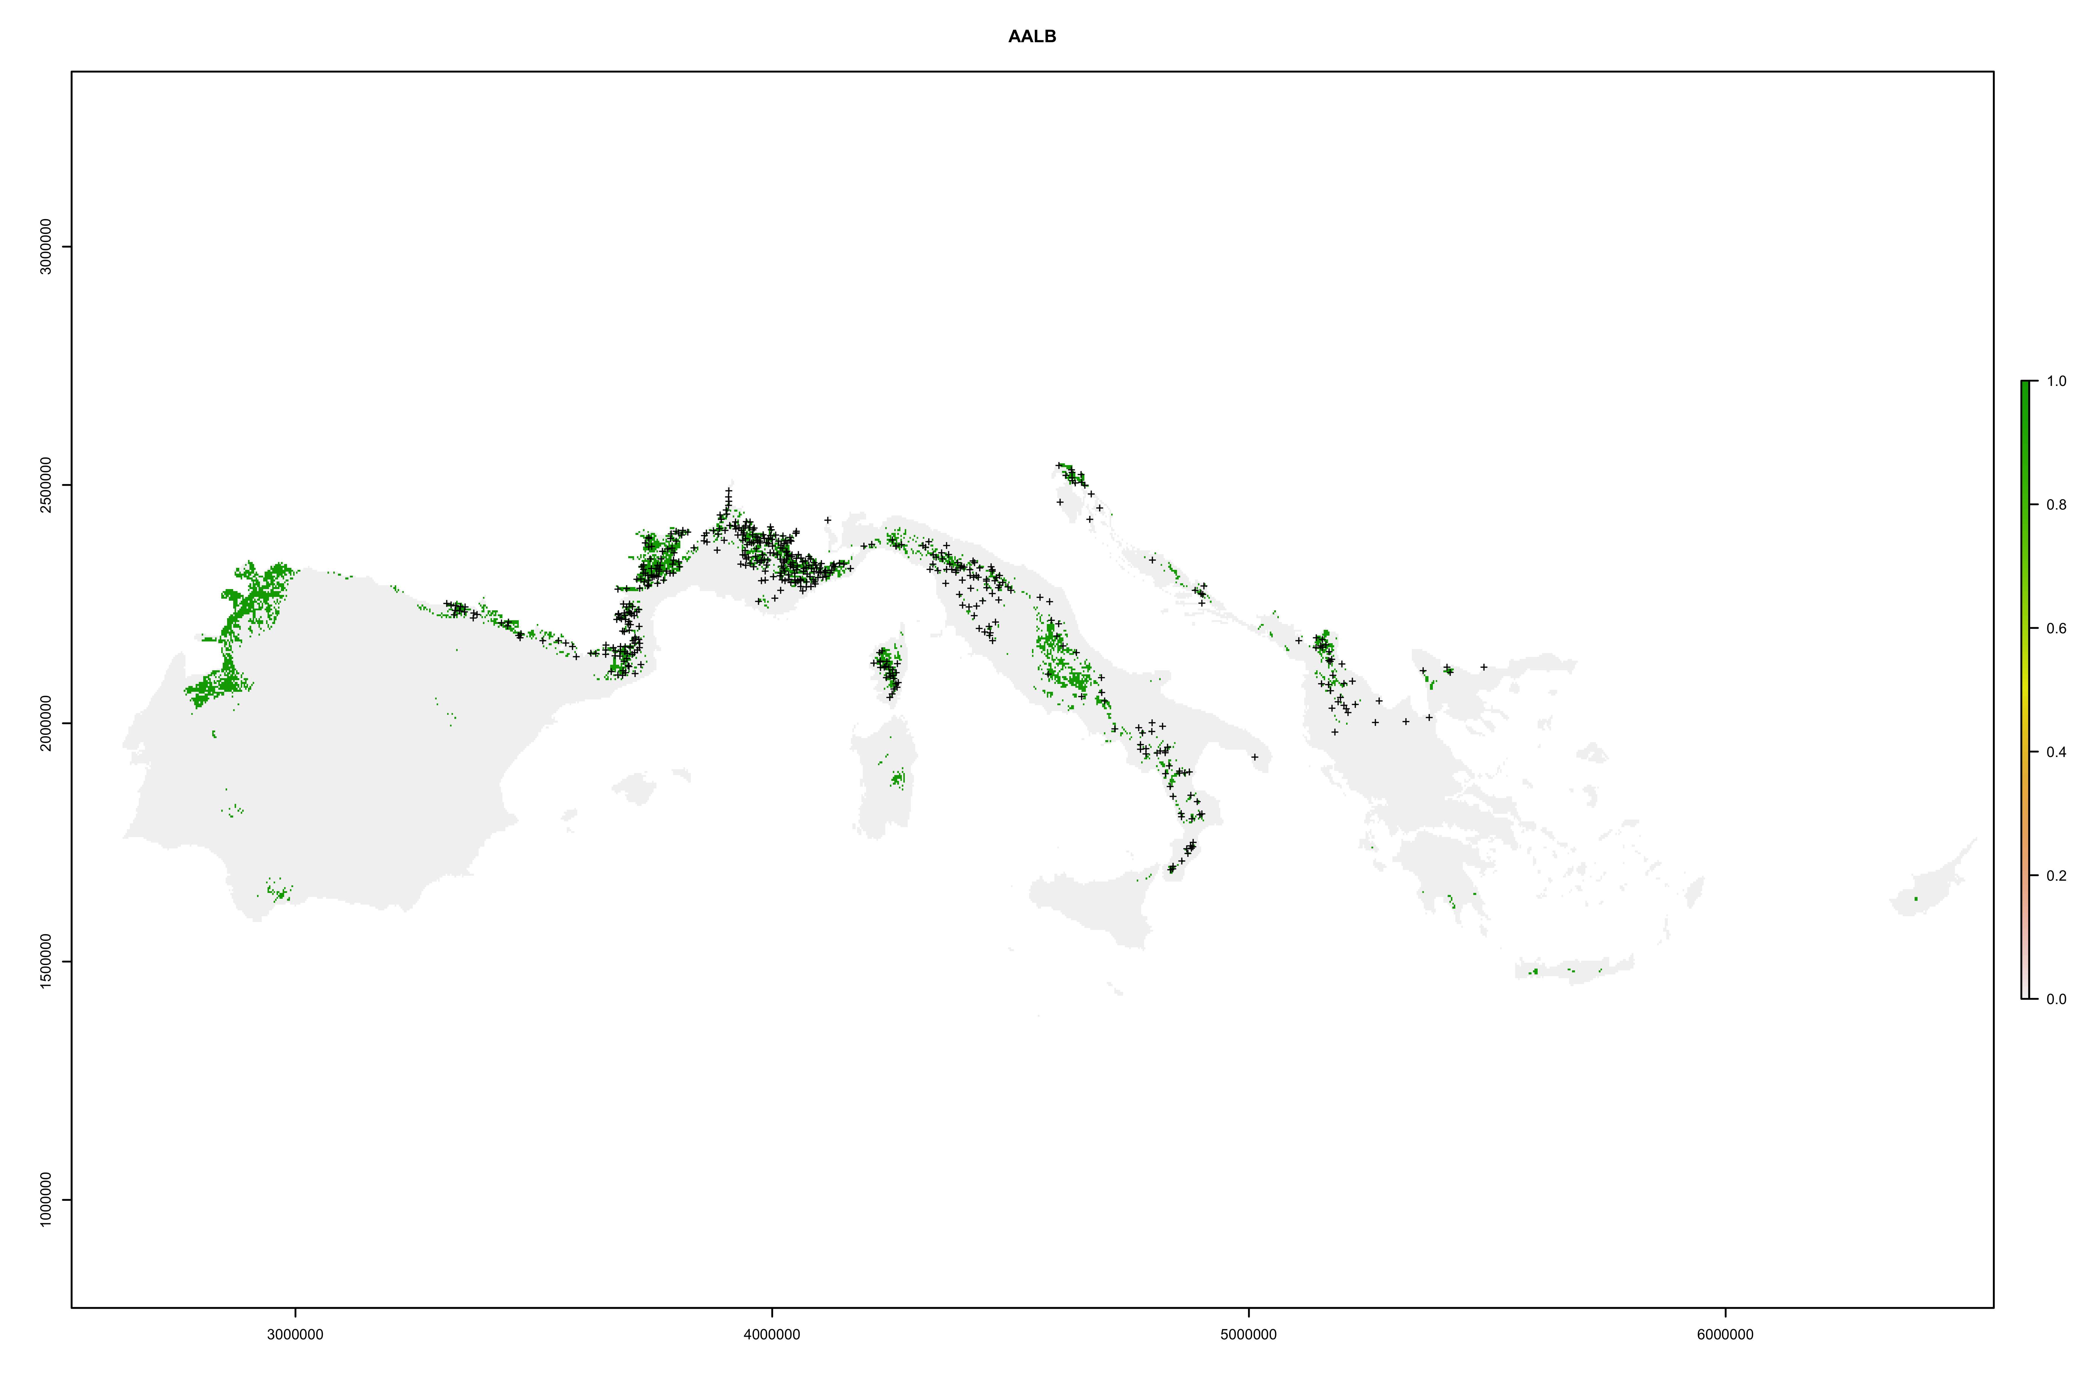
Abies alba
Random selection of PA
TSS = 0,715
Random selection + Disk
TSS = 0,519

Slide 2
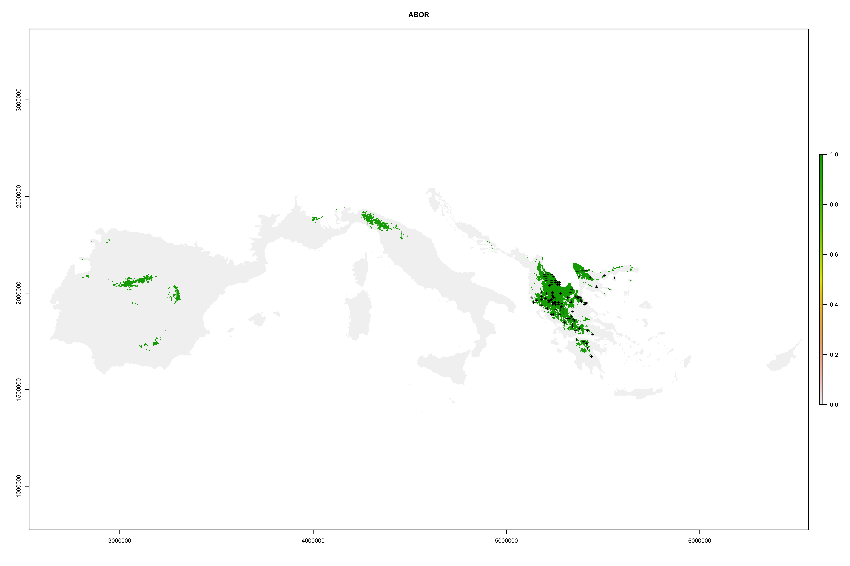
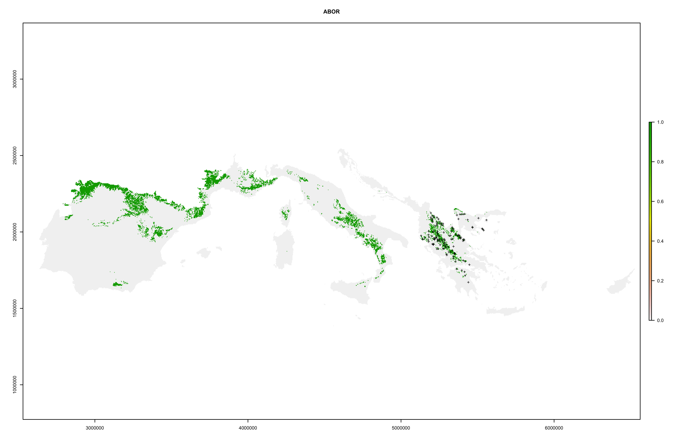
Abies borissi-regis
Random selection of PA
TSS = 0,876
Random selection + Disk
TSS = 0,645

Slide 3
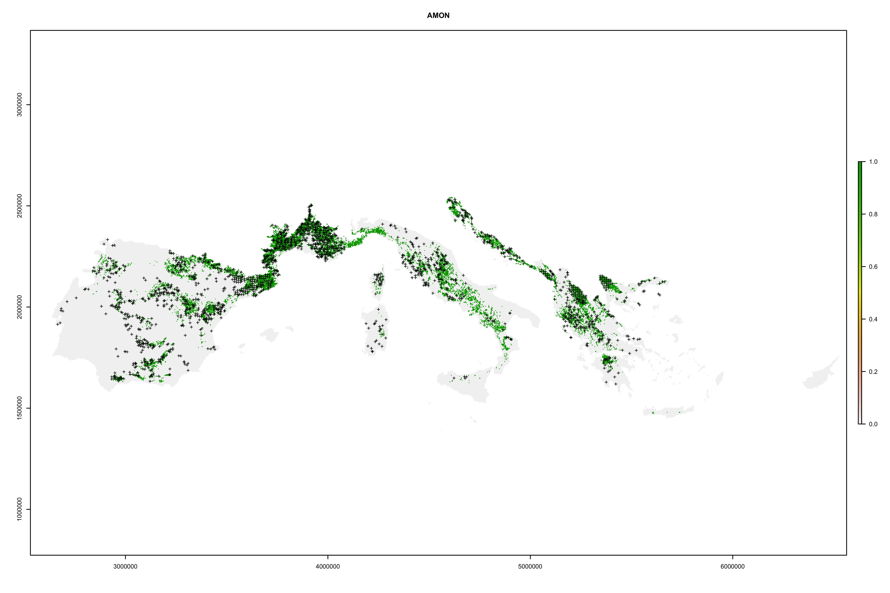
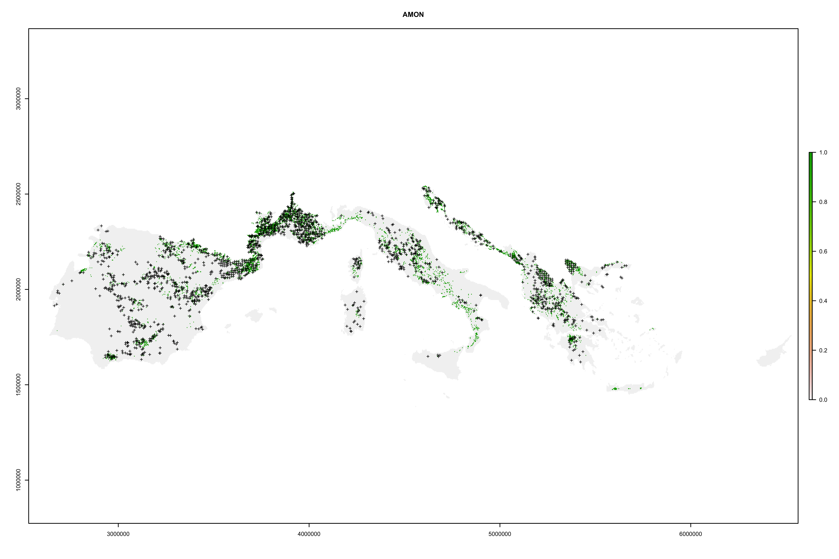
Acer monspessulanum
Random selection of PA
TSS = 0,391
Random selection + Disk
TSS = 0,367

Slide 4
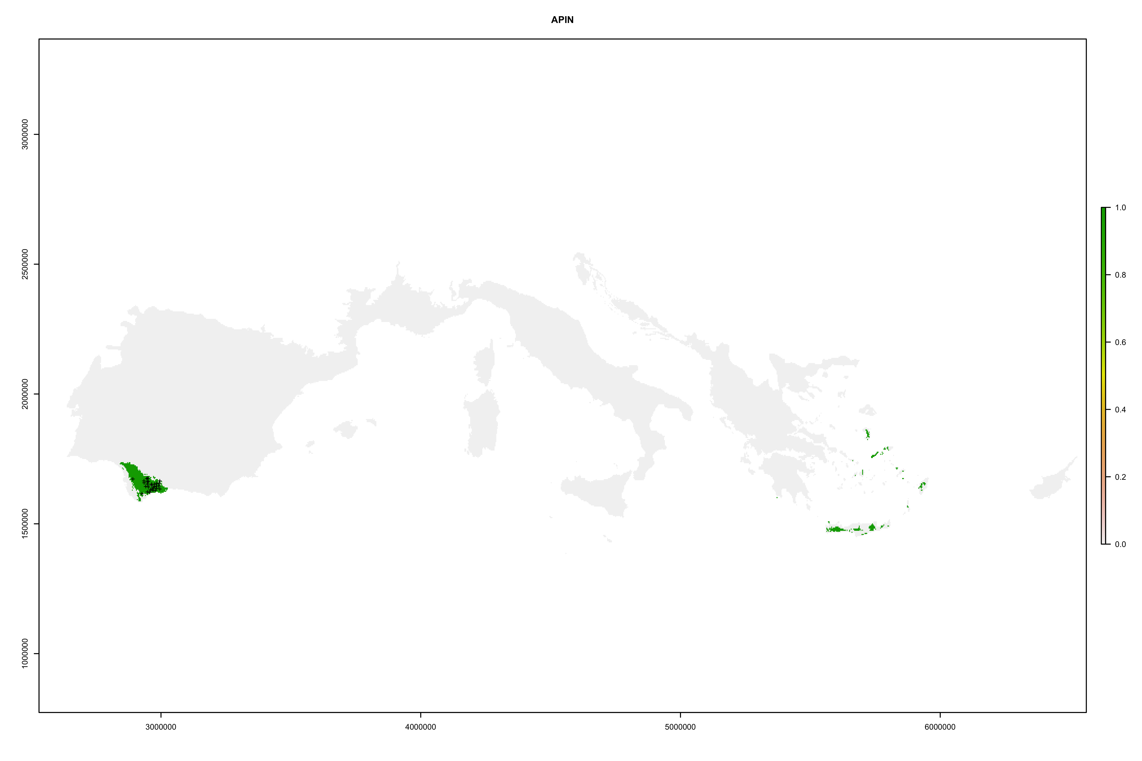
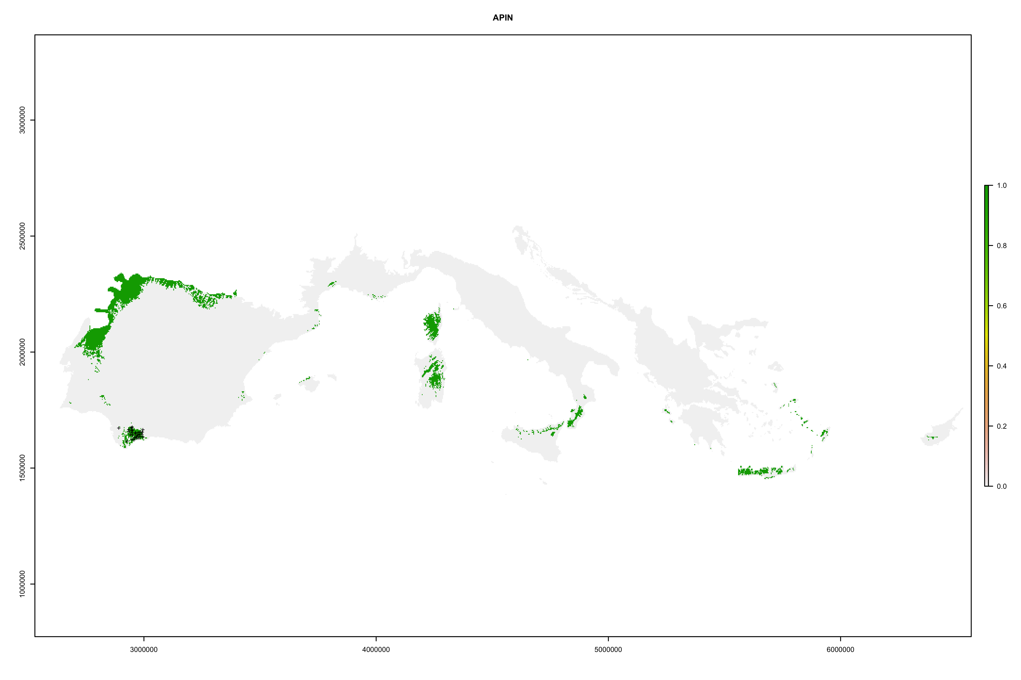
Abies pinsapo
Random selection of PA
TSS = 0,967
Random selection + Disk
TSS = 0,616

Slide 5
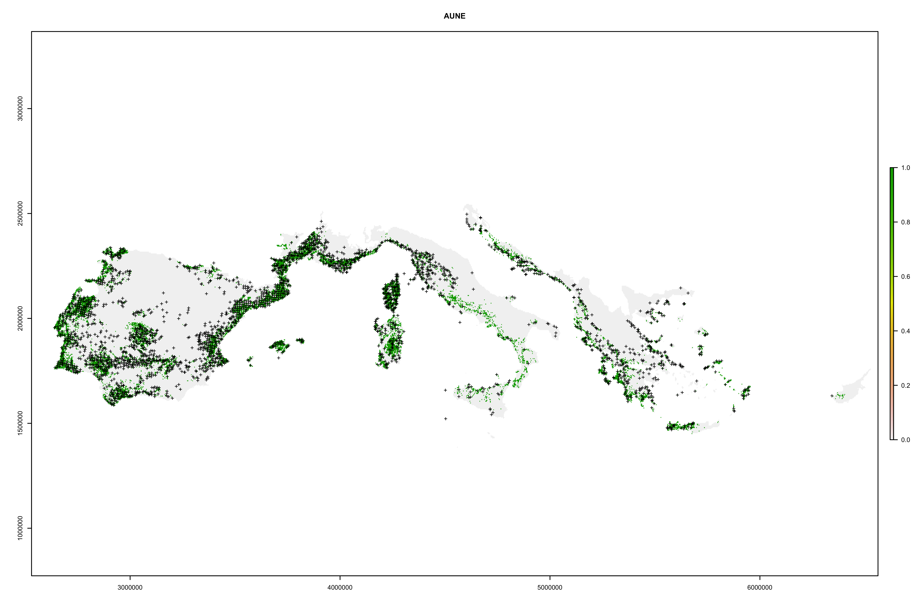
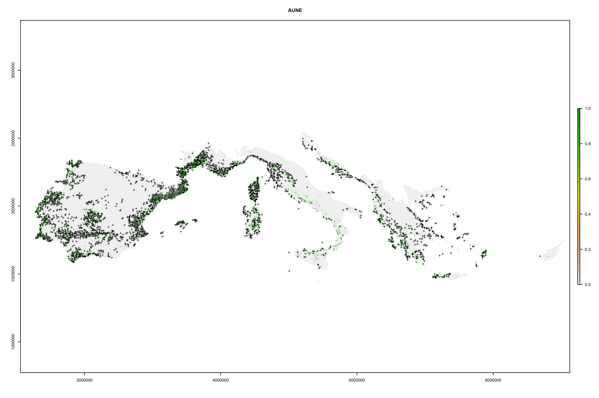
Arbutus unedo
Random selection of PA
TSS = 0,345
Random selection + Disk
TSS = 0,312

Slide 6
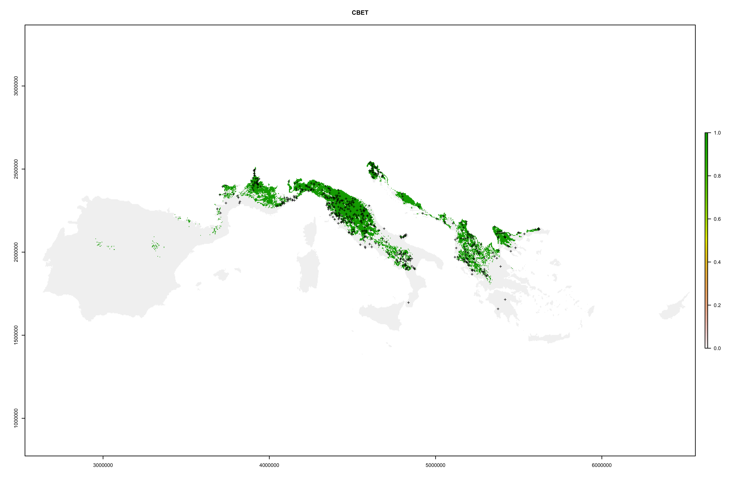
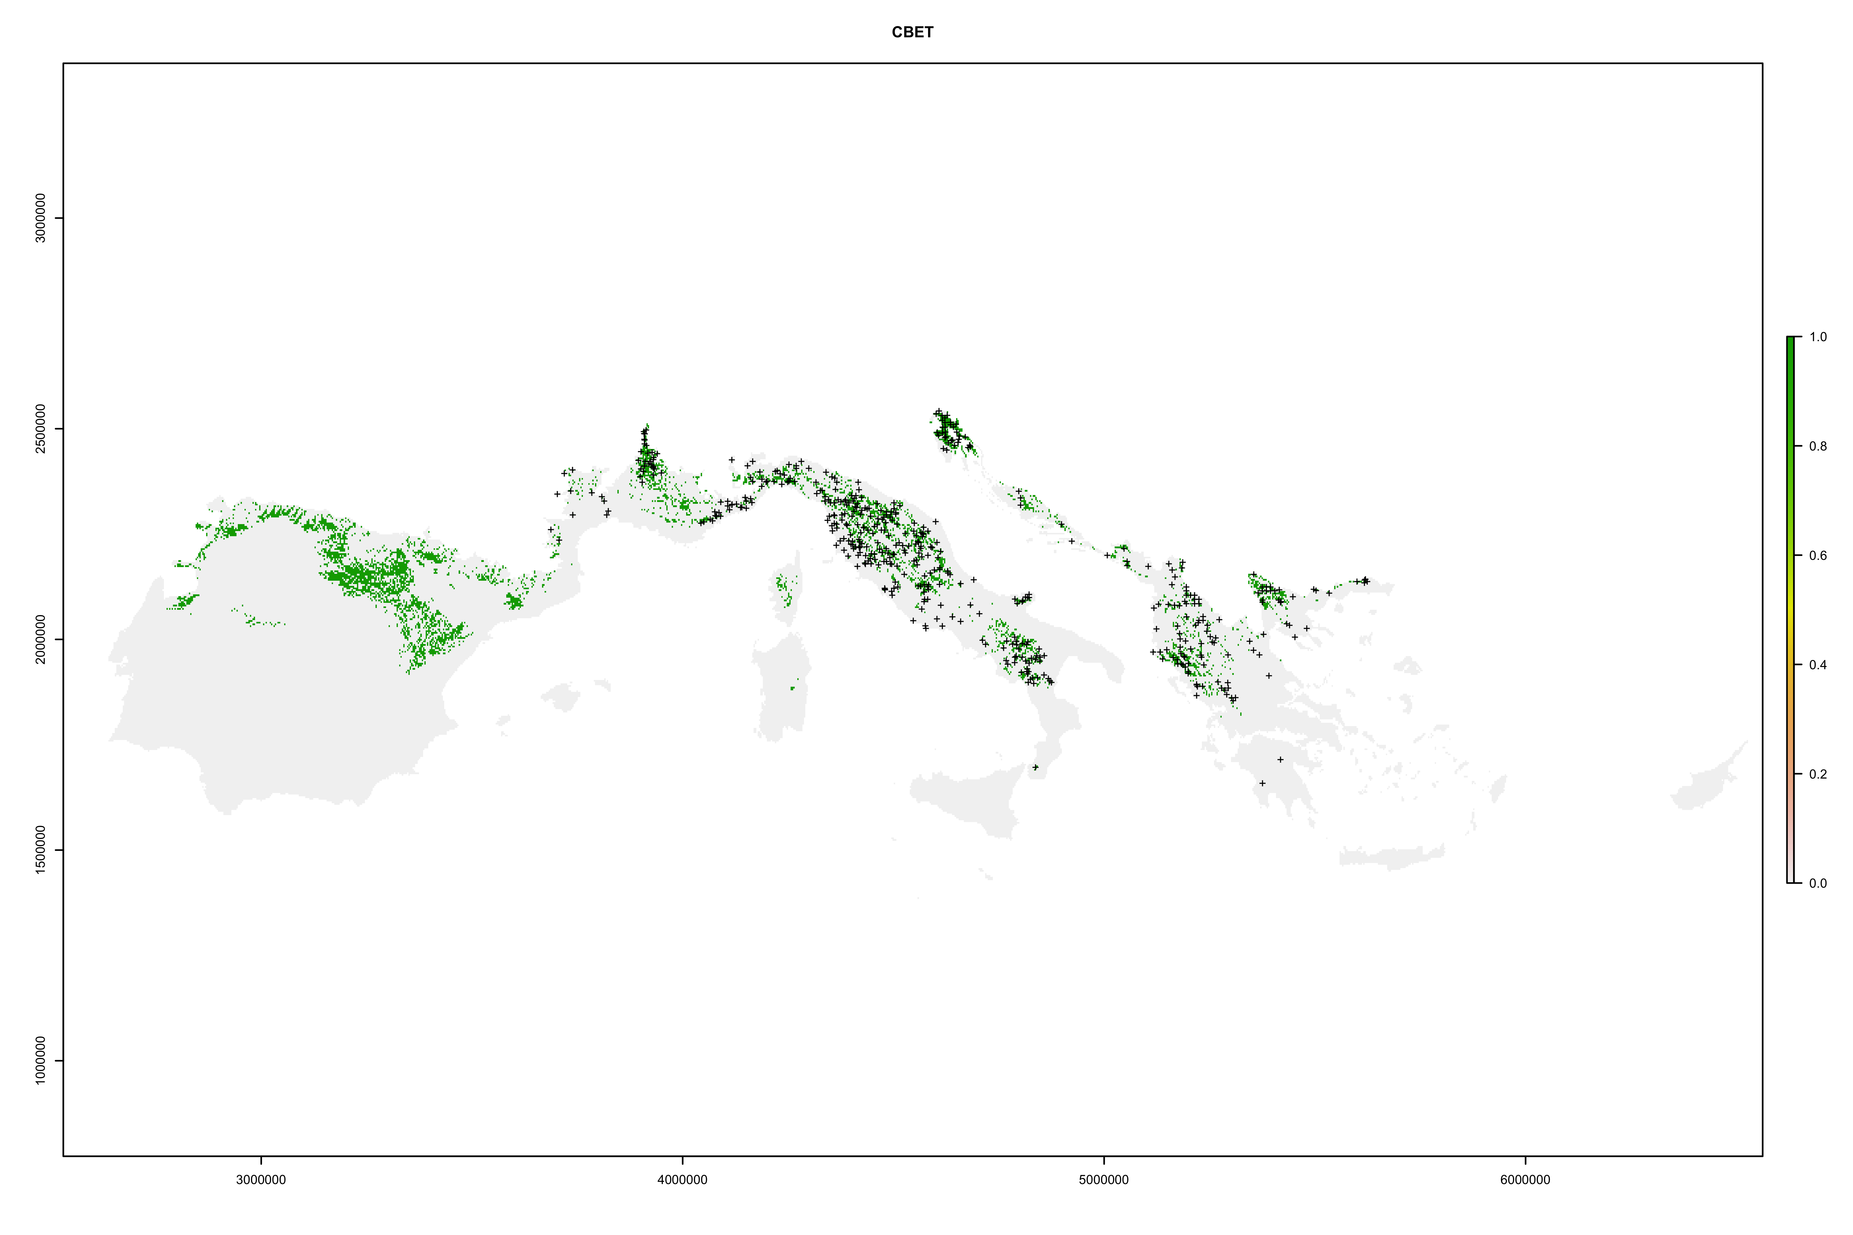
Carpinus betulus
Random selection of PA
TSS = 0,690
Random selection + Disk
TSS = 0,408

Slide 7
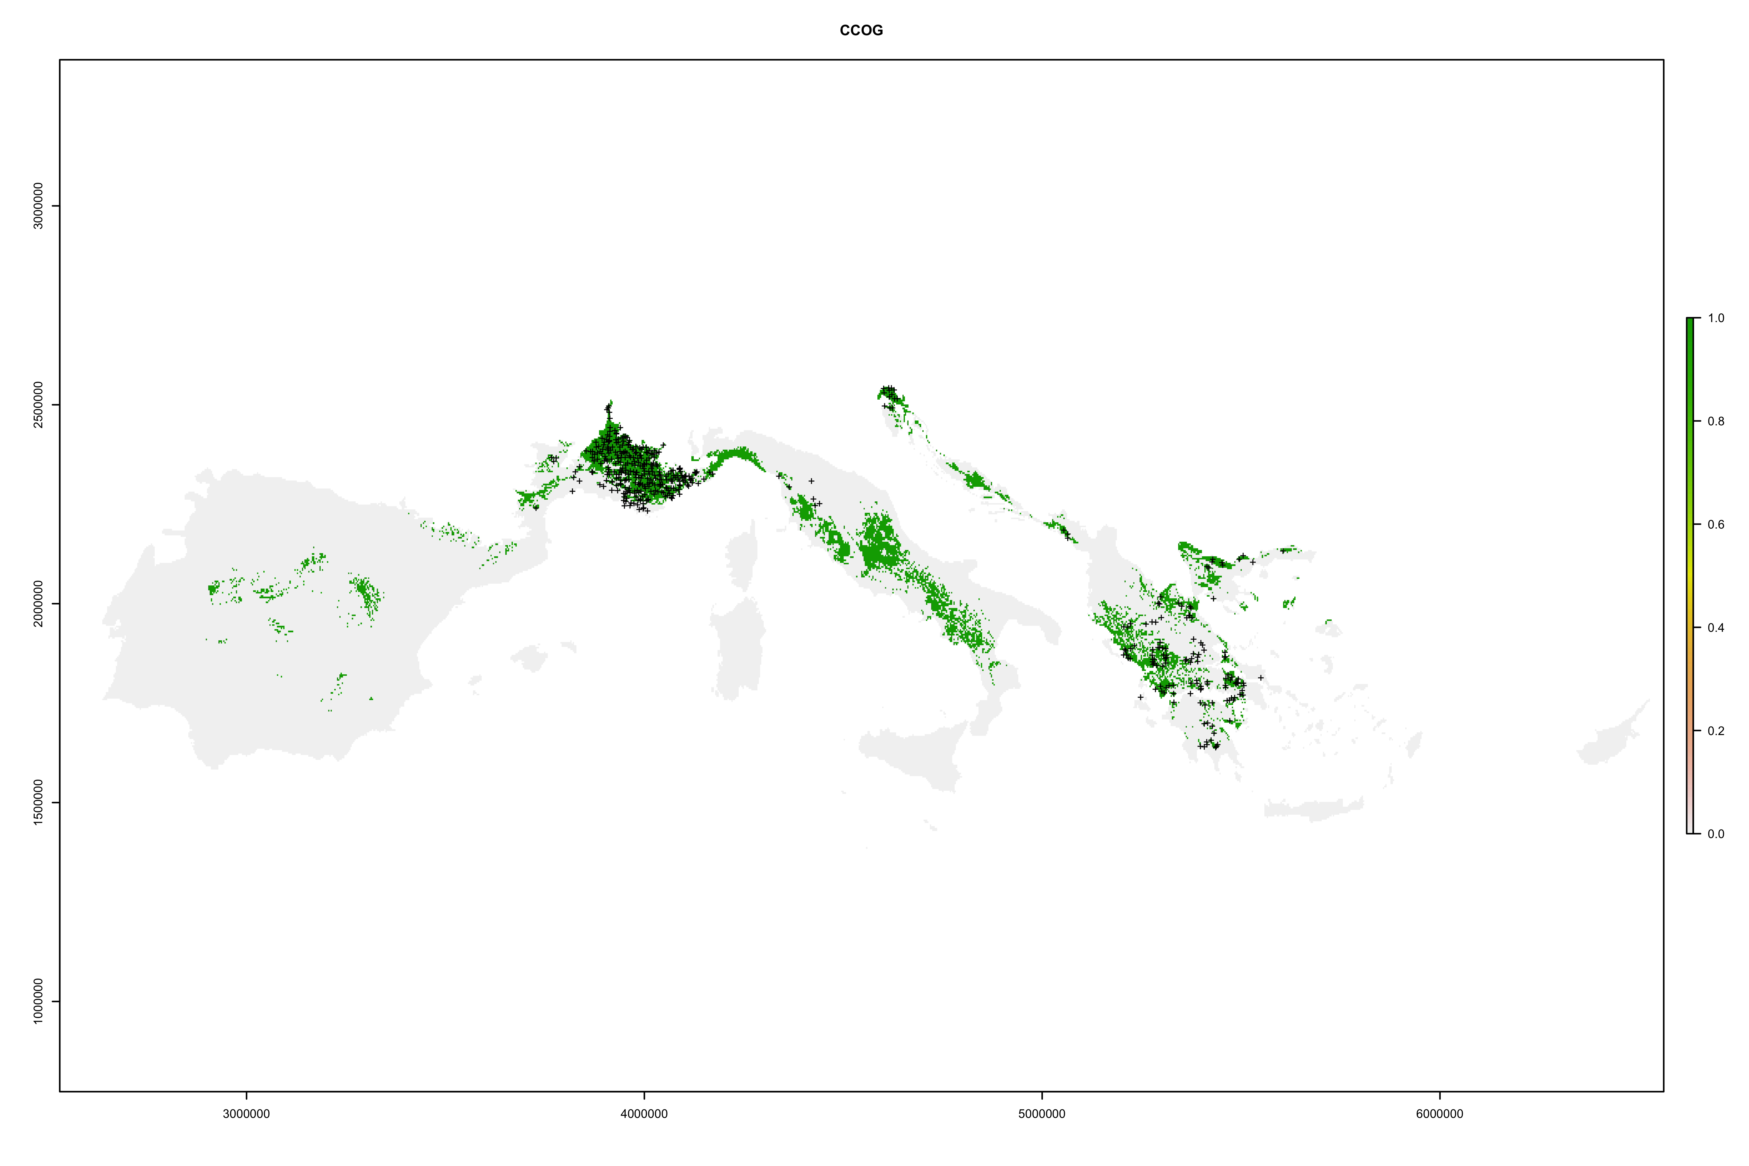
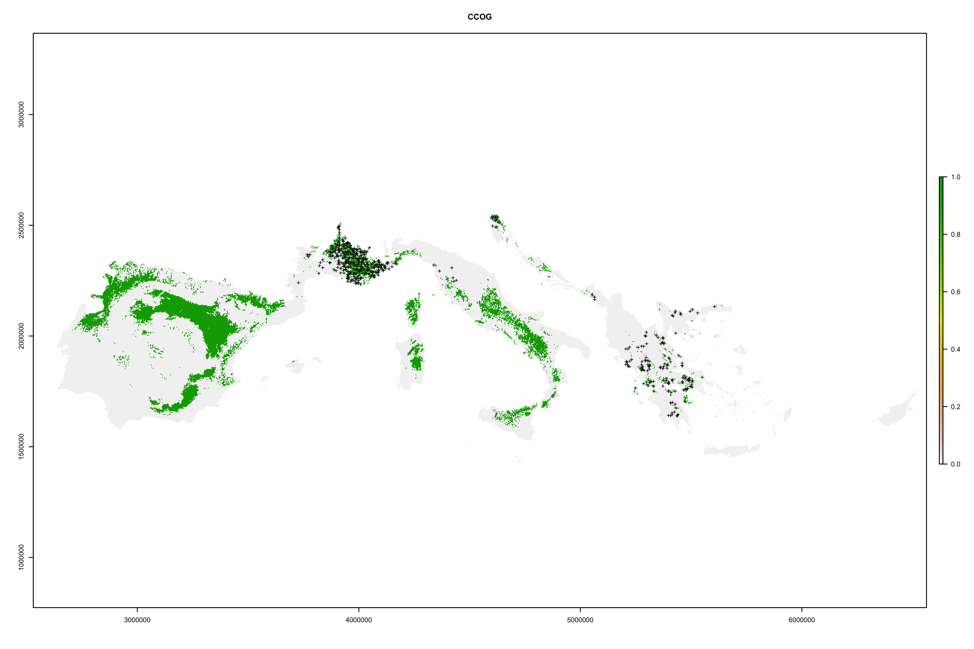
Cotinus coggygria
Random selection of PA
TSS = 0,636
Random selection + Disk
TSS = 0,423

Slide 8
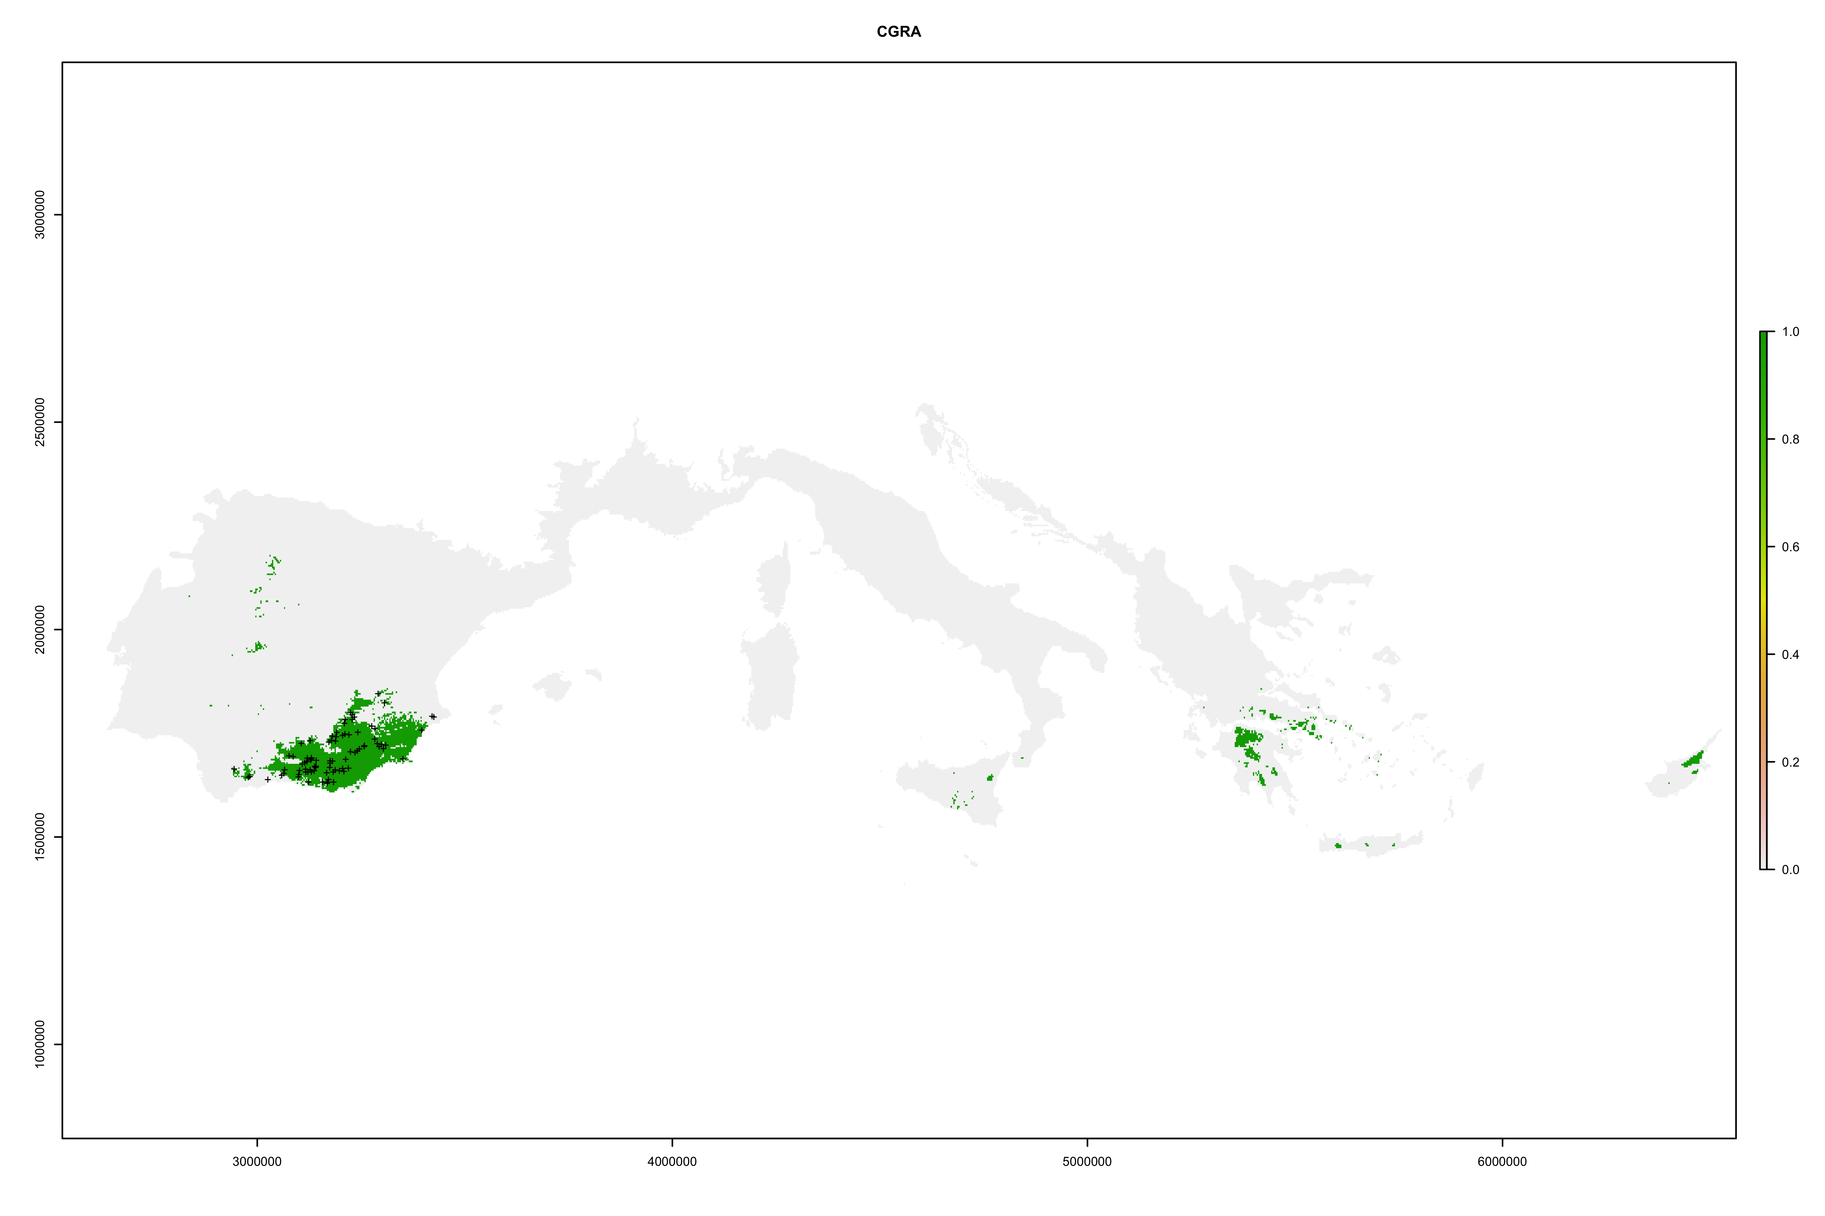
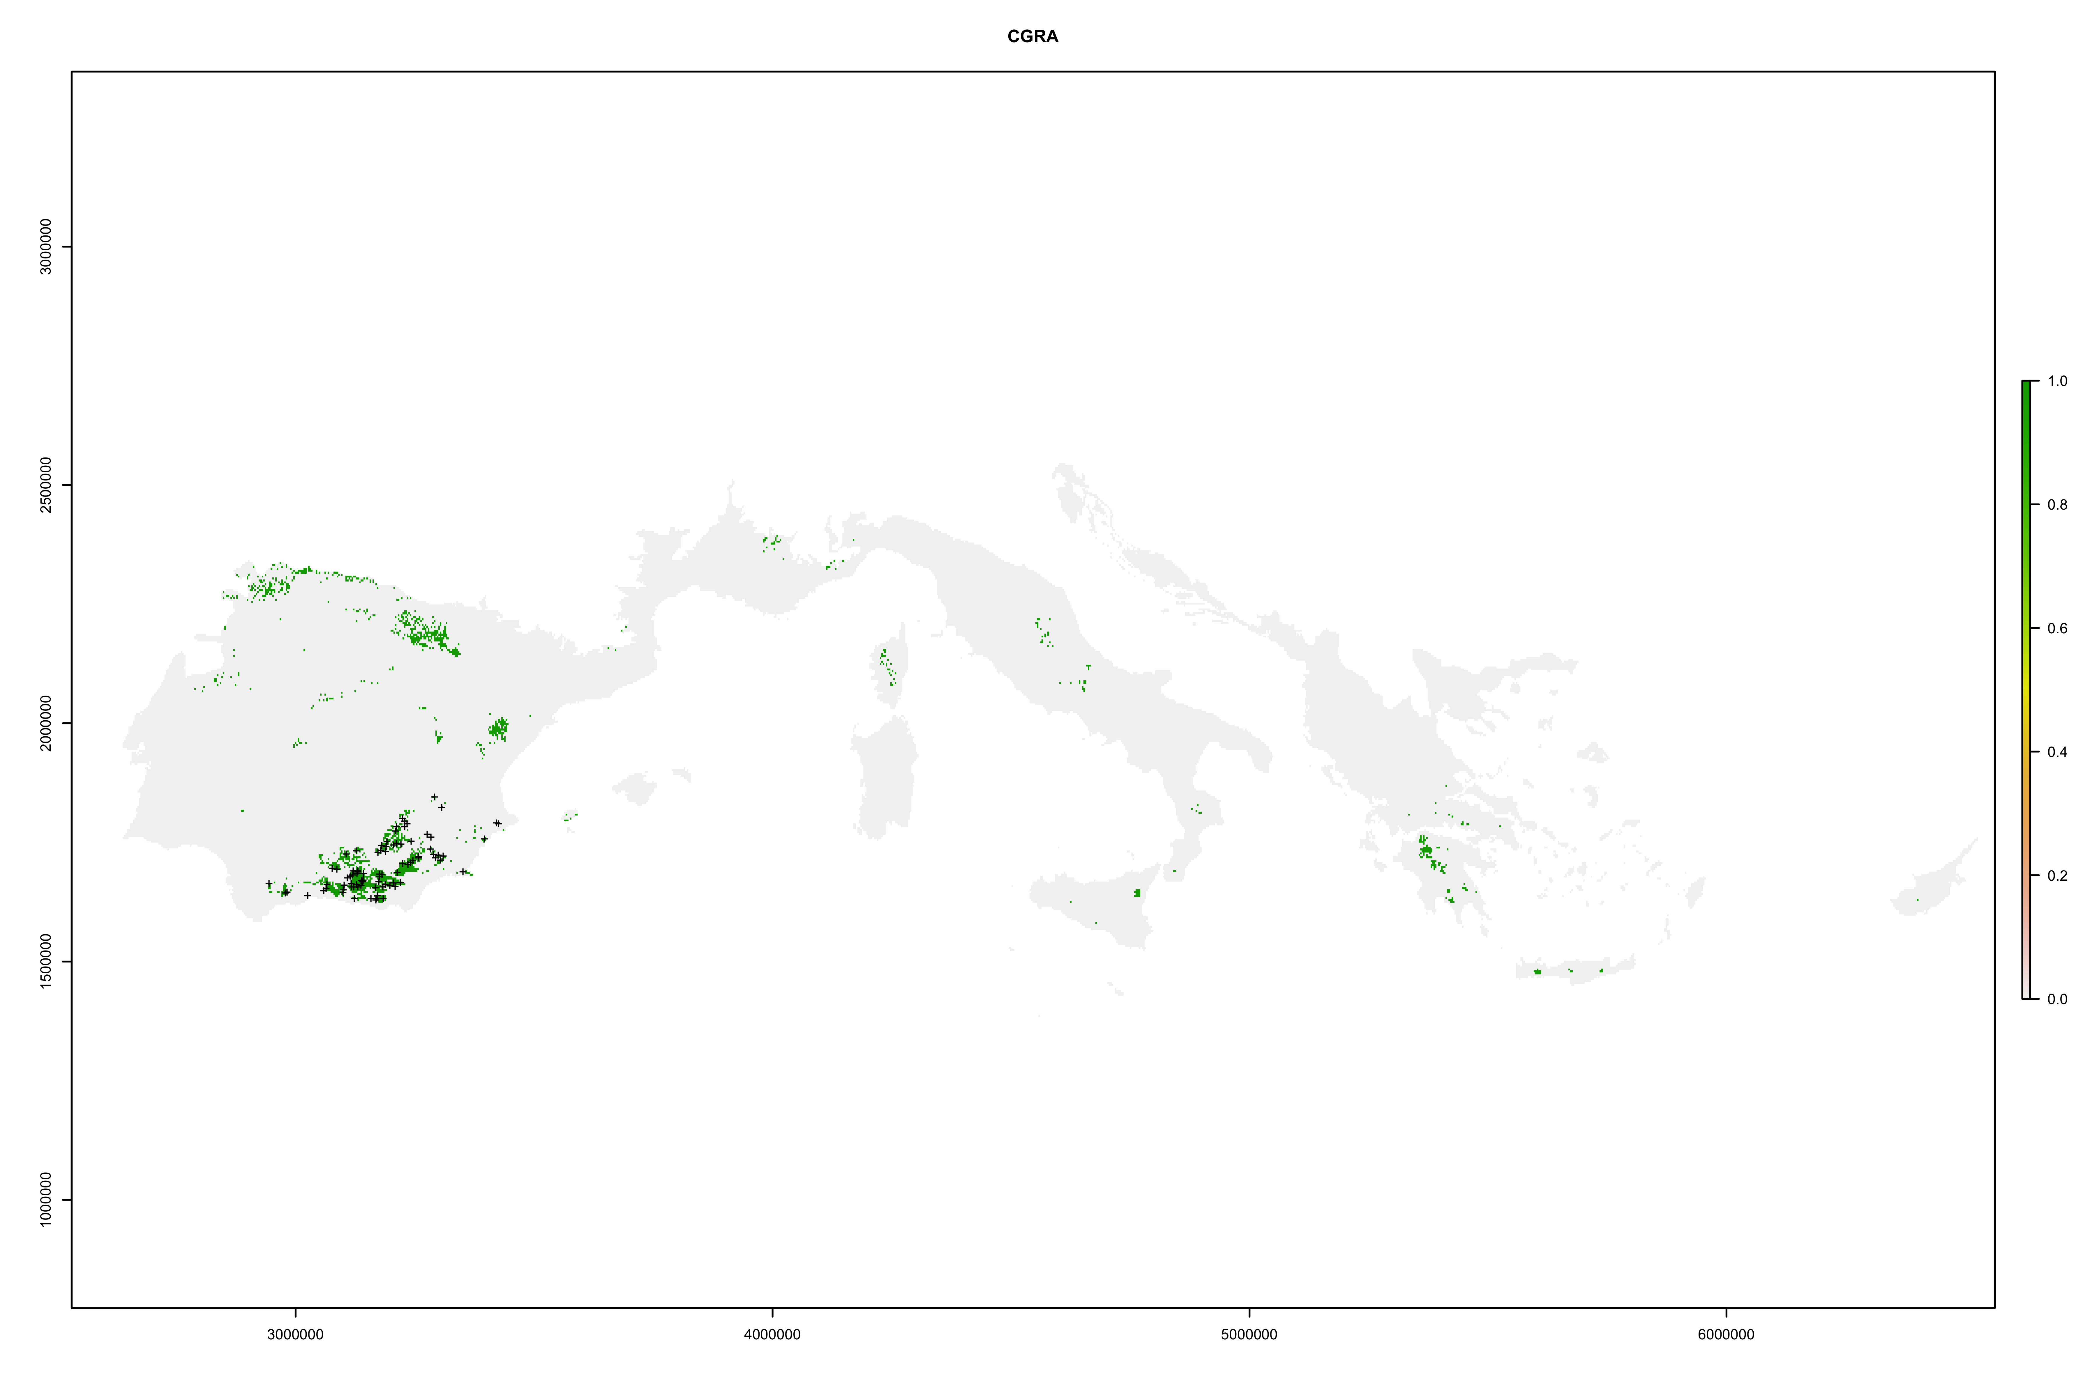
Cotoneaster granatensis
Random selection of PA
TSS = 0,853
Random selection + Disk
TSS = 0,853

Slide 9
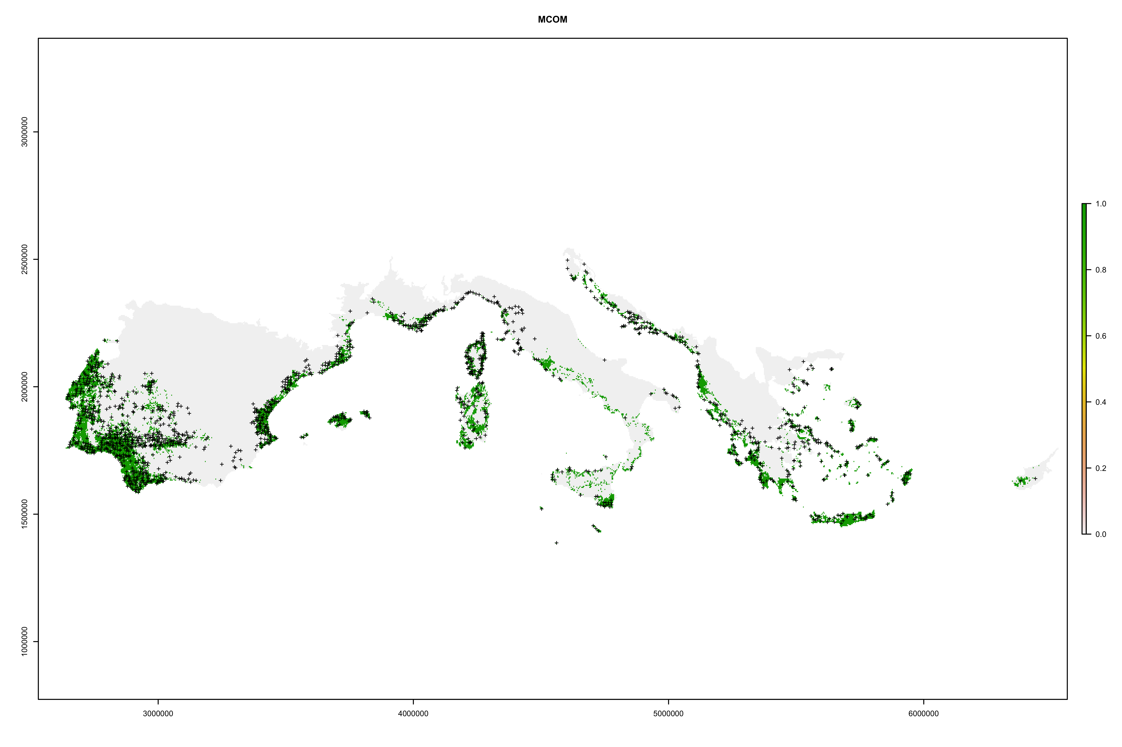
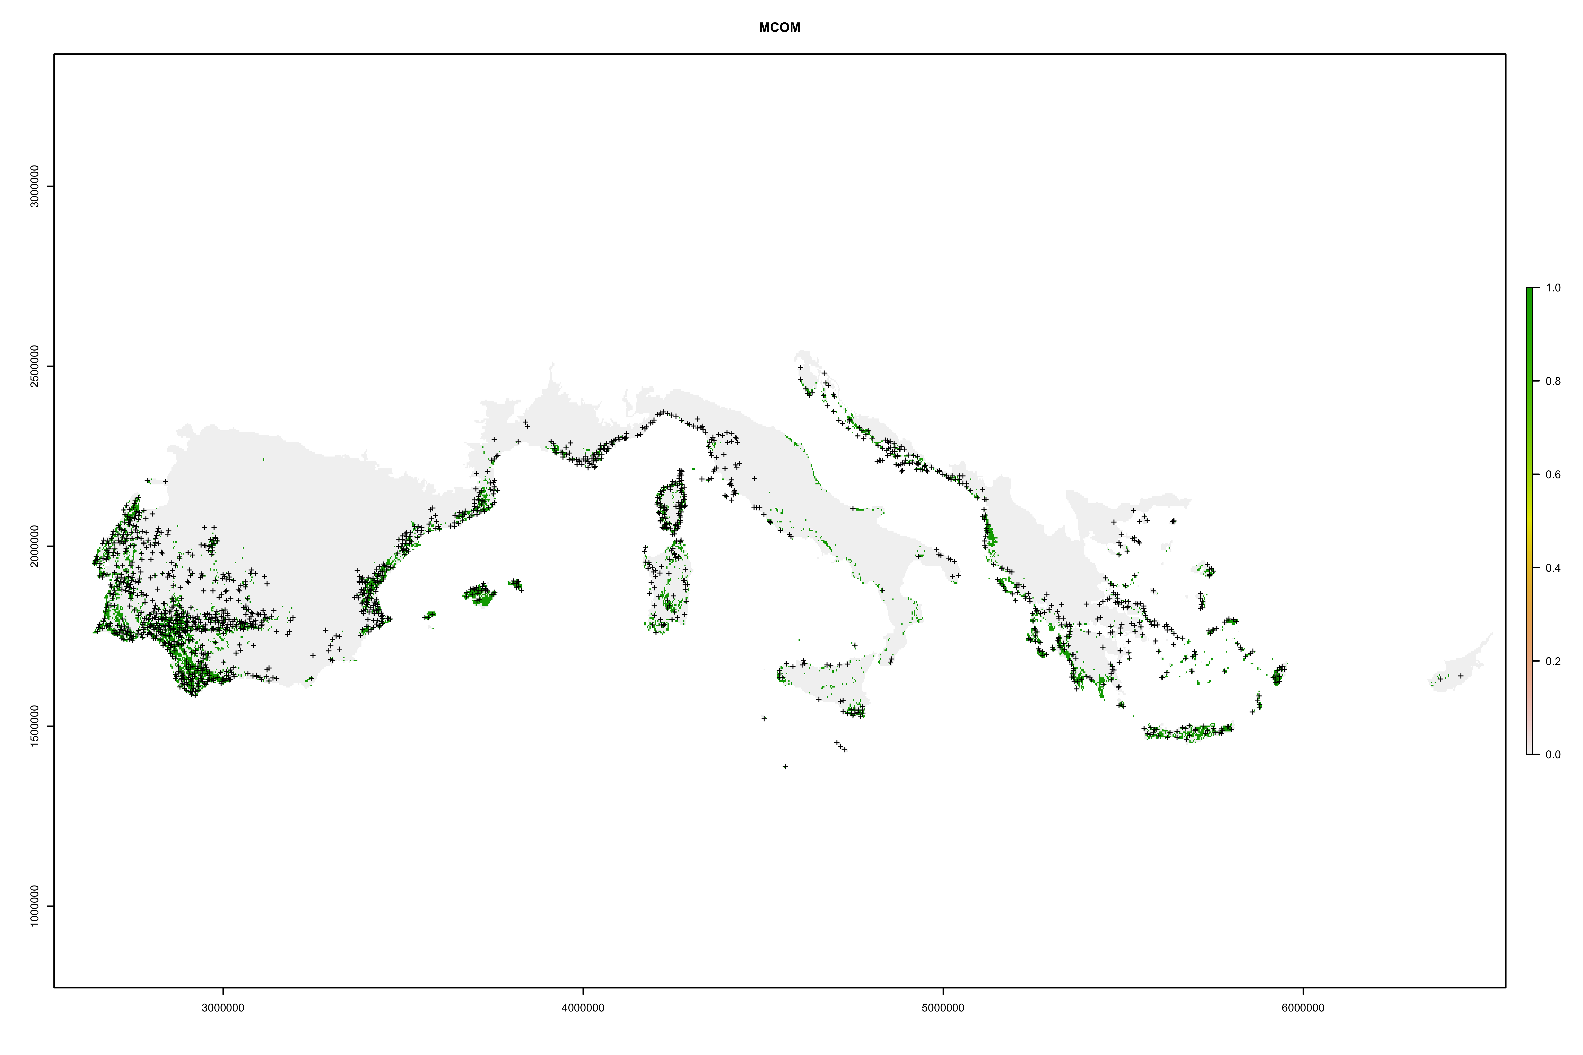
Myrtus communis
Random selection of PA
TSS = 0,508
Random selection + Disk
TSS = 0,443

Slide 10
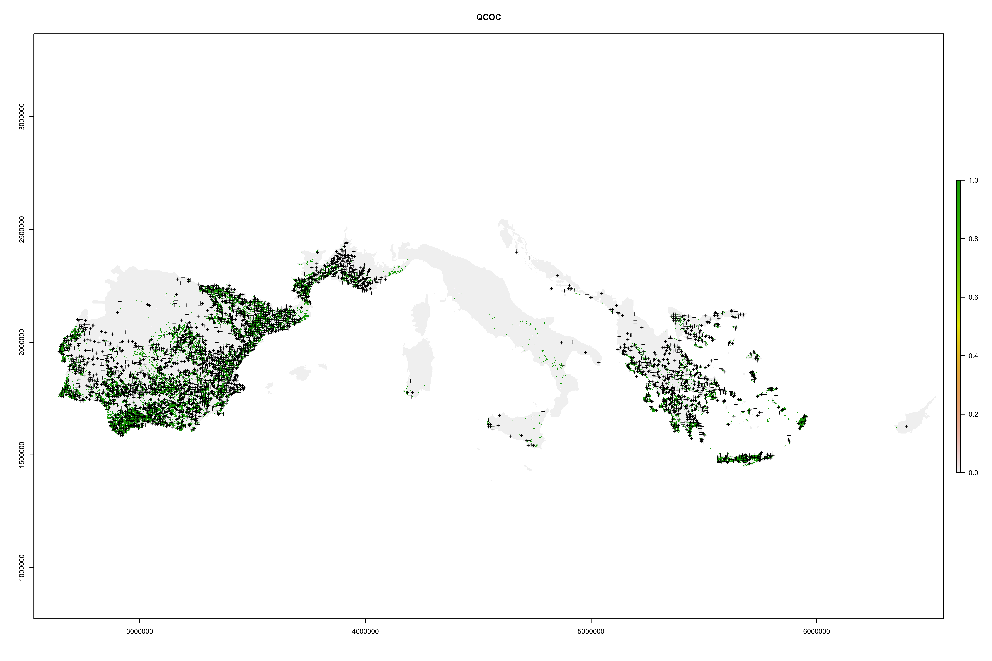
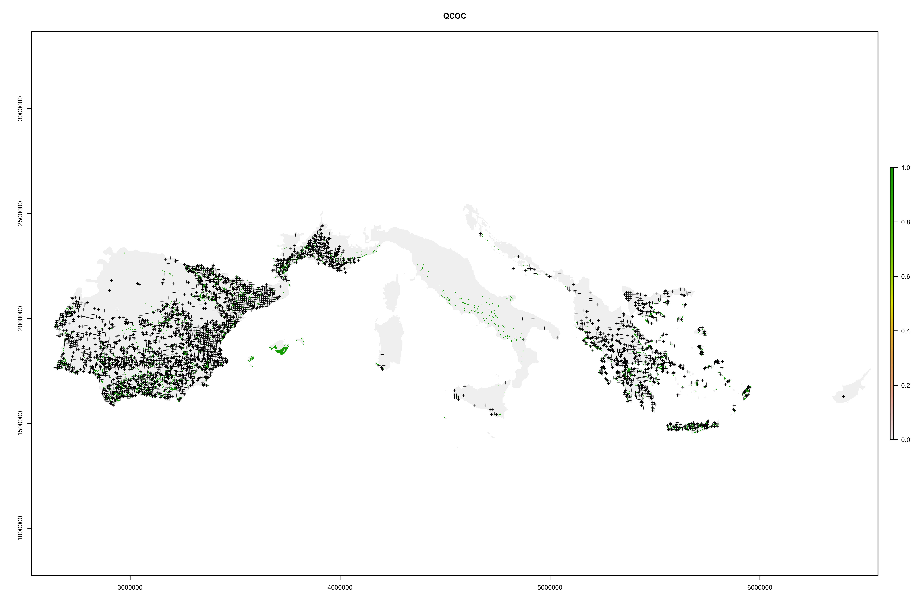
Quercus coccifera
Random selection of PA
TSS = 0,305
Random selection + Disk
TSS = 0,423

Slide 11
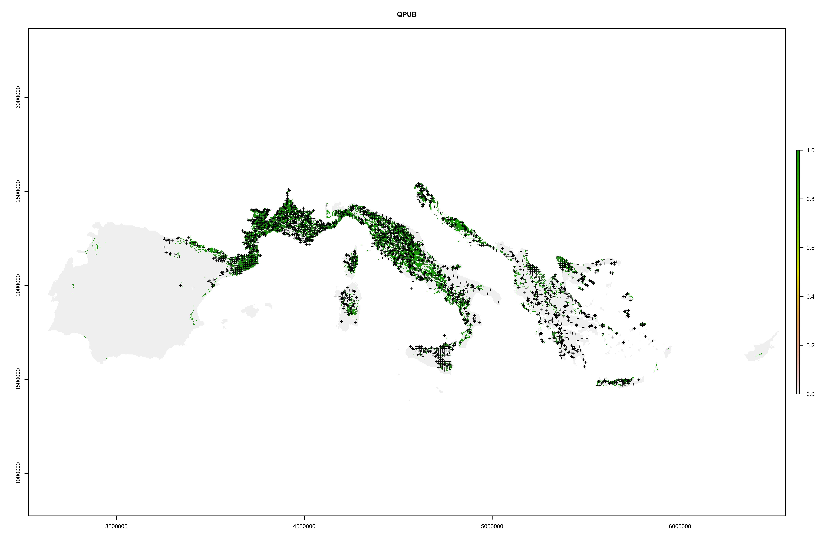
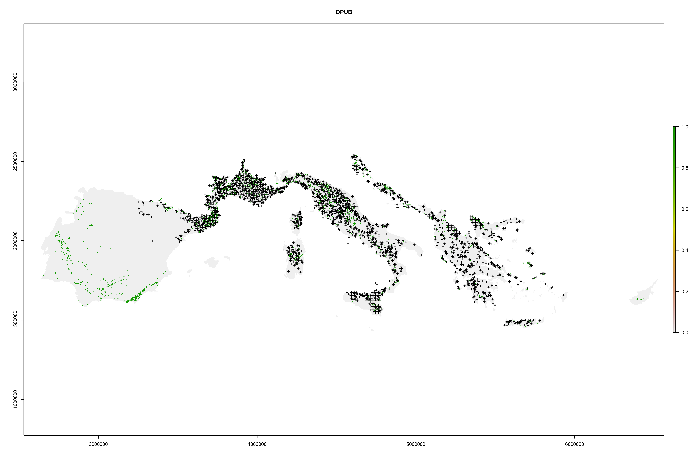
Quercus pubescens
Random selection of PA
TSS = 0,458
Random selection + Disk
TSS = 0,233

